Slide 1
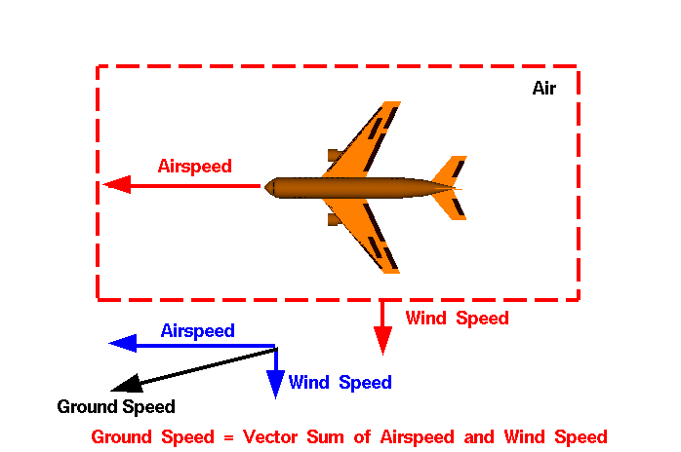
Frames of Reference and
Relative Velocity

Slide 2
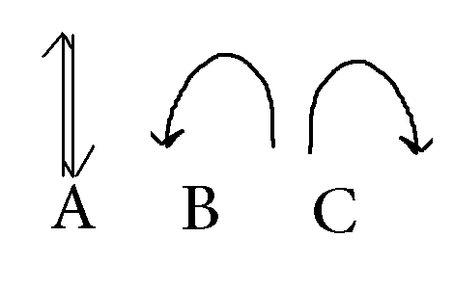

1.A boy on a skateboard, moving at a constant velocity forward, tosses a ball straight up in the air. Which of the following diagrams correctly shows the ball’s path from the perspective of THE BOY?
Forward
[Default]
[MC Any]
[MC All]

Slide 3
2. A boy on a skateboard, moving at a constant velocity forward, tosses a ball straight up in the air. Which of the following diagrams correctly shows the ball’s path from the perspective of a person standing on the ground?
Forward

Slide 4
3. A person is walking forward at 5.0 km/h on a train travelling at 42.0 km/h [East]. What is the person’s velocity relative to the ground?
42.0 km/h [East]
37.0 km/h [West]
47.0 km/h [East]
37.0 km/h [East]
[Default]
[MC Any]
[MC All]

Slide 5
4. A person is walking backwards at 3.0 km/h on a train travelling at 50.0 km/h [North]. What is the person’s velocity relative to the ground?
47.0 km/h [North]
53.0 km/h [North]
50.0 km/h [North]
47.0 km/h [South]
[Default]
[MC Any]
[MC All]

Slide 6
Frames of Reference
Frames of reference video....

